Slide 1
Building UNET Architecture with Transfer Learning

Slide 2
UNET Crash Course
UNET uses a series of upsampling and downsampling blocks to combine object detection and image segmentation
Transfer Learning Ideal: use a well defined, pre-trained model as the object detection/classification block of the UNET structure to save training effort

Slide 3
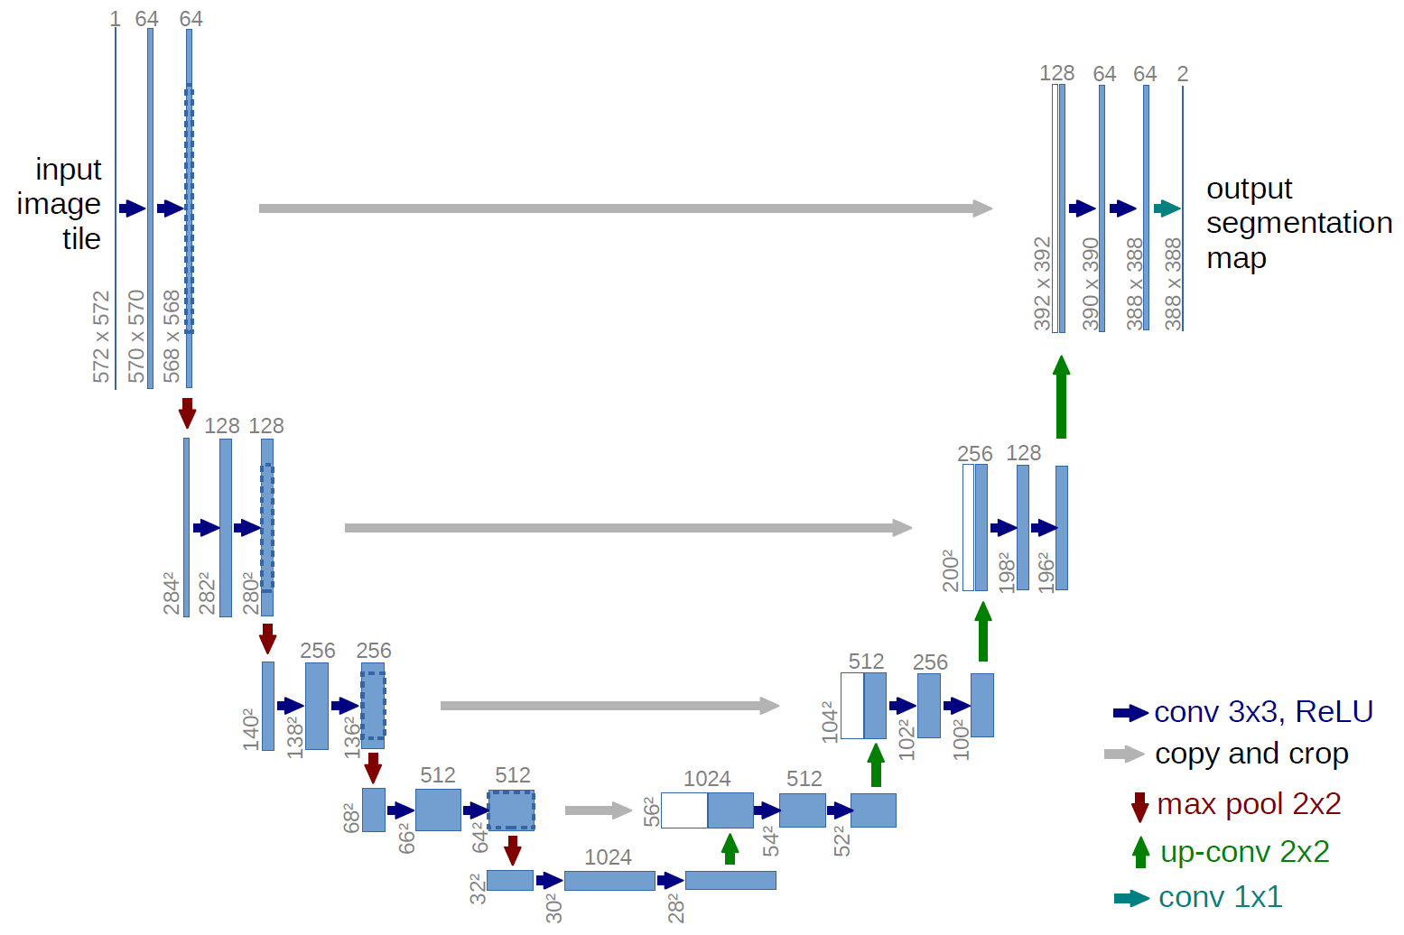
downsample/feature extraction
upsample/decode
Notes:
https://lmb.informatik.uni-freiburg.de/people/ronneber/u-net/

Slide 4
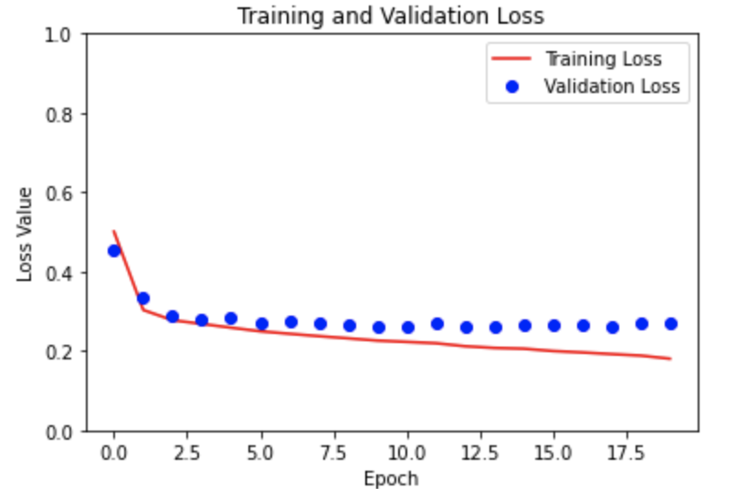
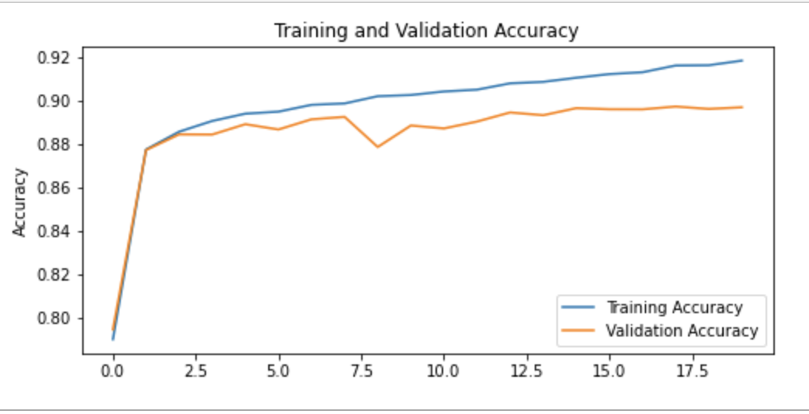
MobileNet vs ResNet - Which base model shows best preliminary results?
MobileNet
Accuracy: 92.12%
Loss: 17.79%
ResNet
Accuracy: 91.85%
Loss: 18.4%

Slide 5
Results
The difference doesn’t appear to be substantial. Both models work well as the backbone of a UNet model.
Notes:
https://www.photopea.com/

Slide 6
Loading trained model for testing…

Slide 7
Loading images for testing
images and masks are simple arrays to hold the test images
i = 0
for path, folders, files in os.walk(test_path):
for file in files:
if (i < 3): # 3 is used here as a placeholder: only testing 3 images
images.append(os.path.abspath(os.path.join(test_path, file)))
masks.append(os.path.abspath(os.path.join(mask_path, file)))
i += 1
else:
break
test_path and mask_path are variables containing the absolute path of the directory containing their respective image files

Slide 8
Displaying results:
for i in range(len(images)):
sample_image = images[i]
sample_mask = masks[i]
pred_mask = predictions[i]
display([sample_image, sample_mask, pred_mask])
predefined arrays containing images
def display(display_list):
plt.figure(figsize=(12,12))
title = ['Input Image', 'True Mask', 'Predicted Mask']
for i in range(len(display_list)):
plt.subplot(1, len(display_list), i+1)
plt.title(title[i])
try:
plt.imshow(display_list[i])
except:
img = plt.imread(display_list[i])
plt.imshow(img)
plt.axis('off’)
plt.show()
display is a method that does the work to show the images given in array format

Slide 9
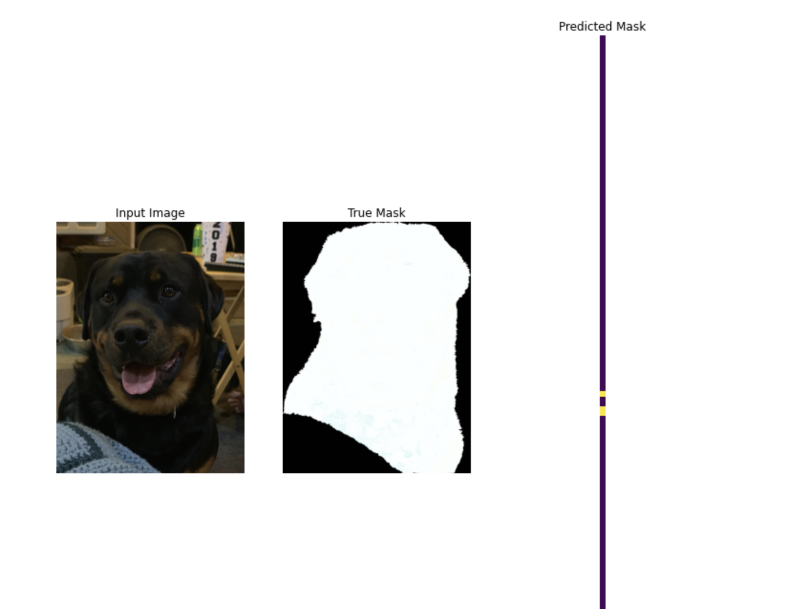
prediction is a wip
def create_mask(pred_mask):
# pred_mask = np.squeeze(pred_mask)
# cause of predicted mask being a weird outcome
pred_mask = tf.argmax(pred_mask, axis = -1)
pred_mask = pred_mask[..., tf.newaxis]
return pred_mask[0]

Slide 10
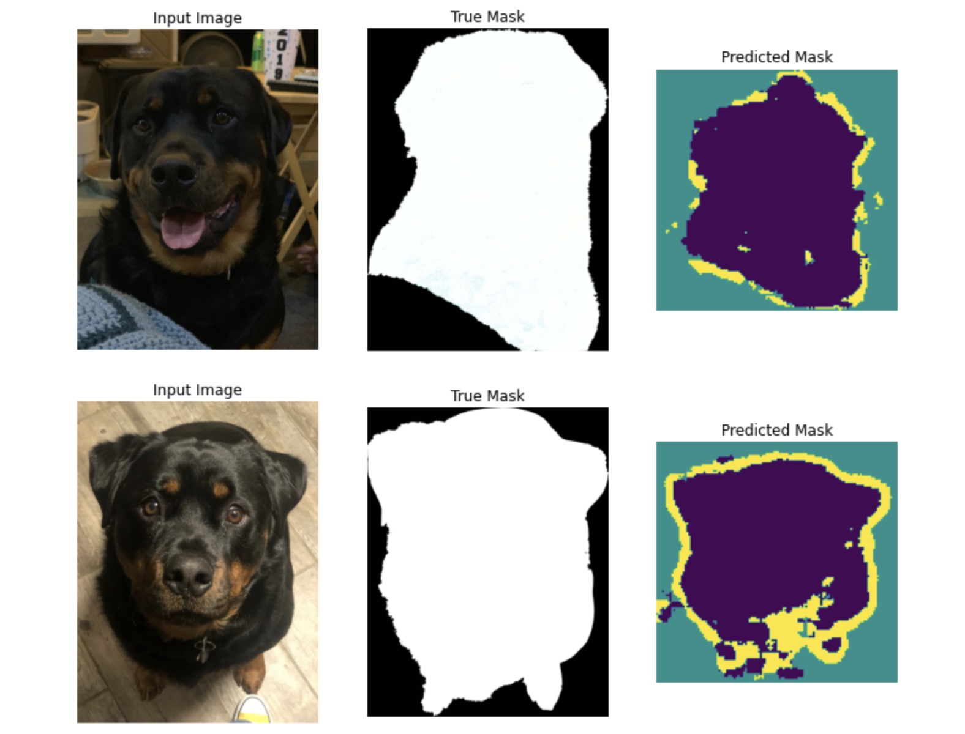
Results
The predictions are not as good as the training set, but the predicted mask is noticeably close to the true mask.

Slide 11
Next Steps
check the accuracy of the predictions
is there another [better] way to make the predictions
is the model saved correctly?
  weight vs whole model?

